Slide 1
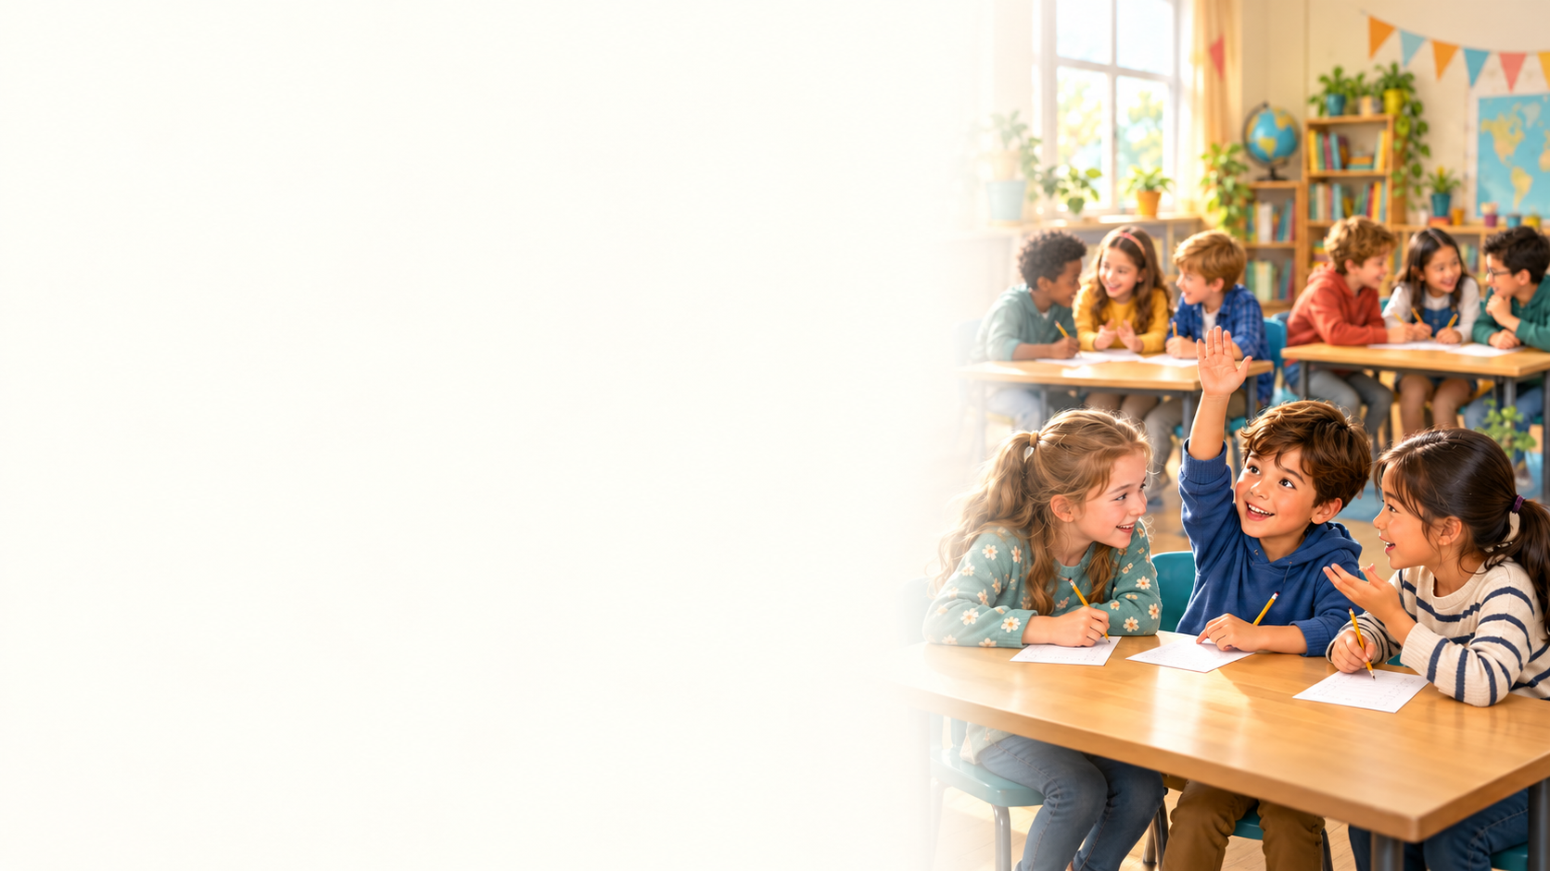

Test 1
1. Why does Mark look worried?
A) He needs to borrow some money.
B) He has lost his brother's phone.
C) He has missed football practice.
D) He cannot find Anna.

Slide 2
Test 1
2. What has Emma's cousin recently bought?
A) An expensive car.
B) A new laptop.
C) A family restaurant.
D) A small apartment.

Slide 3
Test 1
3. What was Lisa's first opinion of her
neighbour?
A) He was always angry with children.
B) He was careless with money.
C) He was unfriendly.
D) He was very talkative.

Slide 4
Test 1
4. Why did Leo not do his homework?
A) He had football practice.
B) He was ill all evening.
C) He was visiting his grandparents.
D) He forgot his schoolbag.

Slide 5
Test 1
5. Why did Ben buy the laptop so quickly?
A) The special offer lasted only one day.
B) His old laptop broke that morning.
C) He needed it for an interview.
D) Maya chose the model for him.

Slide 6
Test 1
6. What did Sophie's father advise her to do?
A) Save part of her salary.
B) Give up her job.
C) Spend more on a new phone.
D) Borrow money every month.

Slide 7
Test 1
7. What does Nina's grandfather want to do?
A) Print a picture of his garden.
B) Buy a new phone online.
C) Send a photo to Nina's aunt.
D) Delete a messaging app.

Slide 8
Test 1
8. What does Alex want to do next year?
A) Buy a house for Sam.
B) Live alone in another city.
C) Move in with his parents.
D) Share an apartment with someone.

Slide 9
Test 1
9. How long has Owen lived in his current city?
A) Five months.
B) Twenty years.
C) Two years.
D) Twelve years.

Slide 10
Test 1
10. What would Daniel probably do if he had
enough money?
A) Avoid meeting his colleagues.
B) Work fewer hours.
C) Stop working completely.
D) Start working every night.

Slide 11
Test 1
11. What does Mia's teacher often ask
students to do?
A) Study grammar alone at home.
B) Copy silently for the whole lesson.
C) Watch films without discussion.
D) Work in pairs.

Slide 12
Test 1
12. Which set of items would Noah take
abroad?
A) A camera, a dictionary and an expensive watch.
B) Family photos, a small guitar and a coffee cup.
C) A photo album, a book and a grandmother's gift.
D) A laptop, sports shoes and a large suitcase.

Slide 13
Test 1
13. Why is Kevin wearing formal clothes?
A) He is going to football practice.
B) He has an interview that afternoon.
C) He is attending Sara's birthday.
D) He has started a new school term.

Slide 14
Test 1
14. What is the school's online form about?
A) Students' views of their teachers.
B) Teachers' opinions of school meals.
C) Students' plans for university.
D) Parents' choices of school subjects.

Slide 15
Test 1
15. Why is Ava's brother unsure about
university?
A) He has been offered a teaching job.
B) He has not decided what to study.
C) He has already completed a degree.
D) He wants to attend the same course as Lucas.

Slide 16
Test 1
16. What does Chloe praise about her
supervisor's instructions?
A) They are very clear.
B) They change every hour.
C) They are given only through other workers.
D) They contain very few details to guide anyone.

Slide 17
Test 1
17. Why does Hannah's cousin like her girls-
only school?
A) She has fewer lessons each week.
B) She never has to do homework.
C) She feels more confident speaking in class.
D) She can choose all her teachers.

Slide 18
Test 1
18. Why did Daniel's friend leave his safe job?
A) To return to school full time.
B) To work for Priya.
C) To travel without a plan.
D) To start a small business.

Slide 19
Test 1
19. What did Grace's brother learn from their
father?
A) Solving advanced maths problems.
B) Teaching a school class.
C) Cooking.
D) Managing a salary.

Slide 20
Test 1
20. Which quality does Max choose first?
A) Humour.
B) Reliability.
C) Popularity.
D) Intelligence.

Slide 21
Test 1
Answer Key
1. A
11. D
2. A
12. B
3. C
13. B
4. A
14. A
5. A
15. B
6. A
16. A
7. C
17. C
8. D
18. D
9. D
19. C
10. B
20. B

