Slide 1
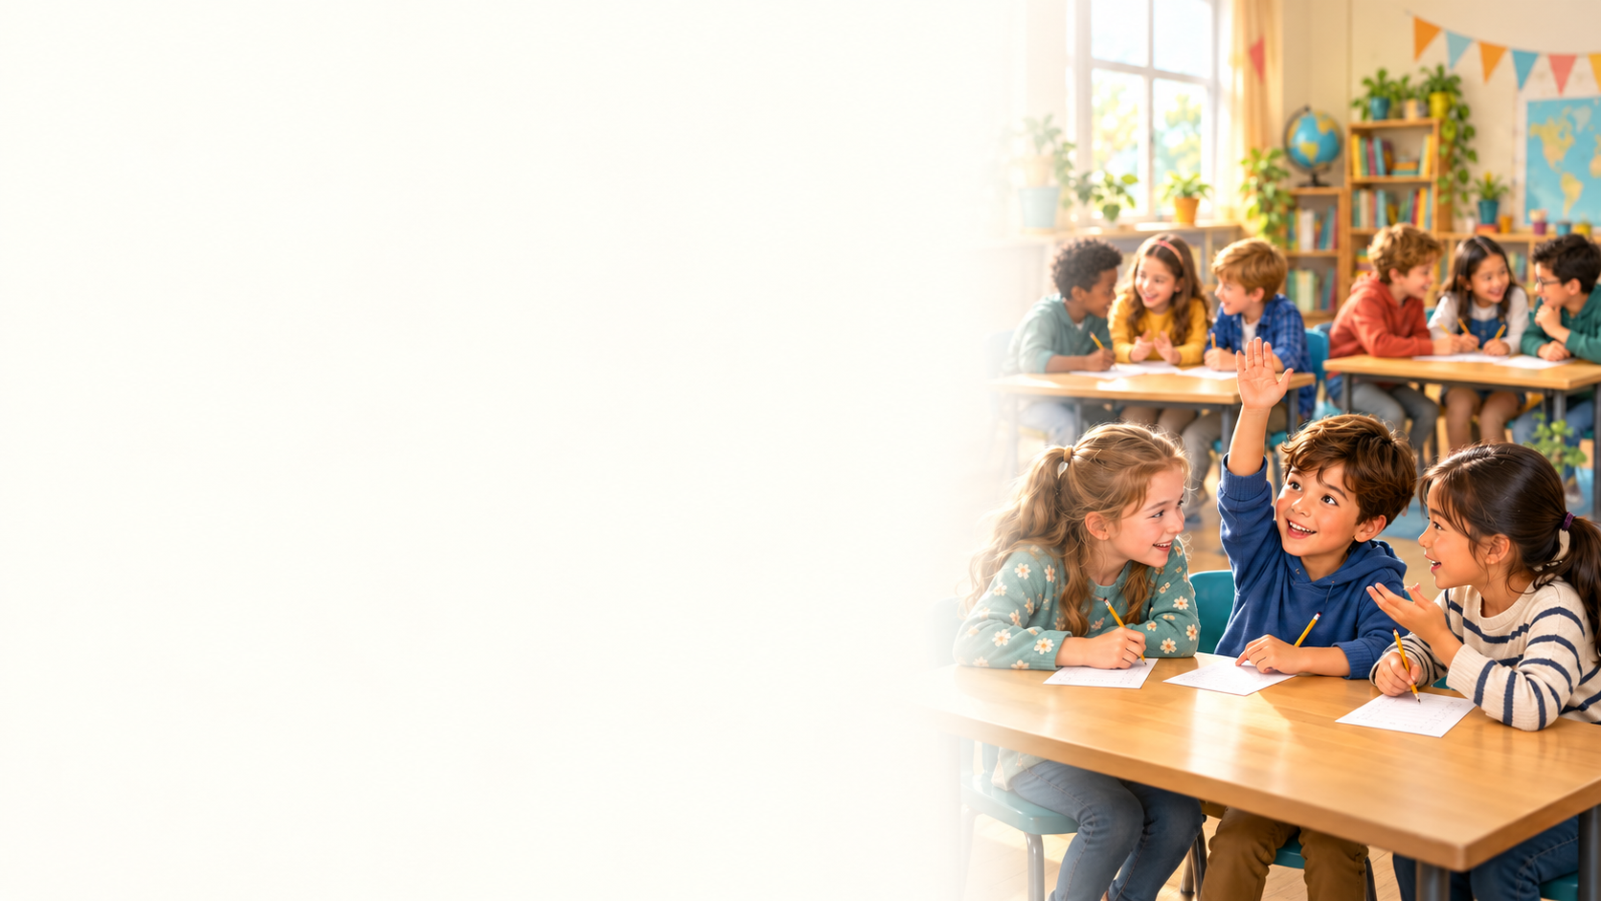

Test 3
1. When must Mark return Anna's money?
A) At the end of the month.
B) On Friday.
C) Before tomorrow morning.
D) On Monday.

Slide 2
Test 3
2. What does Emma say about her uncle?
A) He wants to stop working immediately.
B) He earns more than her cousin.
C) He dislikes spending time at home.
D) He enjoys his job and has time for his family.

Slide 3
Test 3
3. How does Lisa describe the neighbour after
speaking to him?
A) Confident and noisy.
B) Kind but a little shy.
C) Friendly but dishonest.
D) Helpful but impatient.

Slide 4
Test 3
4. Why does the teacher value regular practice?
A) It gives students more free evenings.
B) It makes every subject easy.
C) It helps students remember what they learn.
D) It removes the need for classroom lessons.

Slide 5
Test 3
5. How does Ben feel about his purchase so far?
A) He thinks the laptop is too slow.
B) He wishes he had bought a phone.
C) He wants to return it immediately.
D) He is happy with it.

Slide 6
Test 3
6. What made Sophie reconsider her father’s
advice?
A) Jack offered to lend her money.
B) Her salary suddenly increased.
C) Her father lost his job.
D) Her phone broke and she could not afford a
replacement.

Slide 7
Test 3
7. What did Nina learn from her grandfather
last summer?
A) How to repair a phone.
B) How to send videos.
C) How to make a photo album.
D) How to grow tomatoes.

Slide 8
Test 3
8. What responsibility does Sam mention?
A) Paying the rent on time.
B) Cooking every evening.
C) Buying all the furniture.
D) Organising weekly parties.

Slide 9
Test 3
9. Why does Rachel prefer staying where she is?
A) She has already found work in Owen's new city.
B) She thinks change never helps anyone.
C) She likes knowing her neighbours and area.
D) She wants to avoid learning new skills.

Slide 10
Test 3
10. What matters to Maria at work?
A) Finishing without speaking to anyone.
B) Learning new things.
C) Earning more than every colleague.
D) Avoiding difficult tasks.

Slide 11
Test 3
11. When does Ethan find teacher explanation
especially helpful?
A) When he already knows every answer.
B) When students want a longer break.
C) When the grammar is difficult.
D) When pair work has been cancelled.

Slide 12
Test 3
12. Who gave Lena one of the objects she
would take?
A) Her employer.
B) Noah's father.
C) Her grandmother.
D) Her English teacher.

Slide 13
Test 3
13. How does Kevin feel in sports clothes?
A) Embarrassed.
B) Worried.
C) Formal.
D) Relaxed.

Slide 14
Test 3
14. What concern does Oliver raise?
A) The form asks only about homework.
B) Students may forget their teachers' names.
C) Teachers may refuse to use computers.
D) A low grade may lead to unfair comments.

Slide 15
Test 3
15. How did university affect Ava's sister?
A) It convinced her that learning was unnecessary.
B) It changed how she thinks about the world.
C) It made her stop meeting new people.
D) It helped her avoid making decisions.

Slide 16
Test 3
16. How does the supervisor manage decisions?
A) She allows freedom while checking important work.
B) She leaves all important work unchecked.
C) She controls every small detail.
D) She refuses to let anyone decide anything.

Slide 17
Test 3
17. What possible benefit of separate schools
does Hannah mention?
A) Easier examinations.
B) Fewer distractions.
C) Longer holidays.
D) Lower school fees.

Slide 18
Test 3
18. How is the business doing now?
A) It is slowly growing after a difficult start.
B) It has not opened yet.
C) It was successful immediately.
D) It closed after the first week.

Slide 19
Test 3
19. What happened when Grace's mother
helped her with maths?
A) They finished without any difficulty.
B) Grace decided to teach maths.
C) Her mother asked Leo for a new job.
D) They both became frustrated.

Slide 20
Test 3
20. What is Zoe's view of intelligence in friends?
A) It is less useful than being popular.
B) It always makes people too serious.
C) It is the only quality that matters.
D) It matters, but friends need not know everything.

Slide 21
Test 3
Answer Key
1. B
11. C
2. D
12. C
3. B
13. D
4. C
14. D
5. D
15. B
6. D
16. A
7. D
17. B
8. A
18. A
9. C
19. D
10. B
20. D

