Slide 1
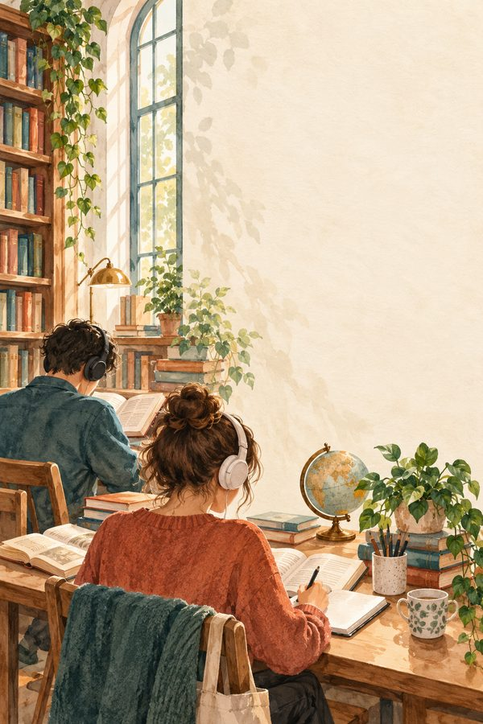

Listening Test 04
Clothes and Behaviour
First listening
Listen for the main idea. The recording starts automatically.
Listen again for details if you need to.
Then answer 10 questions. Choose A, B, C or D.
A2–B1 listening practice
Play / replay audio
BEREKET ELT Archive
Notes:
Source: supplied paragraphs.zip, LP09. Text and questions adapted from supplied Word documents. Decorative background: AI-generated illustration.

Slide 2
Questions 1 and 2
Clothes and Behaviour
1. How may sports clothes make
someone feel?
2. What may change with formal
clothes?
A. Responsible for hotel guests
A. How someone sits, speaks or walks
B. Ready to move and exercise
B. The language someone understands
C. Unable to relax
C. The facts someone remembers
D. Ready for a formal interview
D. A person's whole character
Play / replay audio
BEREKET ELT Archive
Notes:
Source: supplied paragraphs.zip, LP09. Text and questions adapted from supplied Word documents. Decorative background: AI-generated illustration.

Slide 3
Questions 3 and 4
Clothes and Behaviour
3. What can uniforms create?
4. Which worker is mentioned?
A. A sense of role or responsibility
A. A farmer
B. The same personality in everyone
B. A bus mechanic
C. Freedom from all work rules
C. A painter
D. A dislike of every other style
D. A nurse
Play / replay audio
BEREKET ELT Archive
Notes:
Source: supplied paragraphs.zip, LP09. Text and questions adapted from supplied Word documents. Decorative background: AI-generated illustration.

Slide 4
Questions 5 and 6
Clothes and Behaviour
5. Who else may react to clothing?
6. What does clothing NOT
completely control?
A. Other people
A. Behaviour
B. Only close relatives
B. The size of a jacket
C. Nobody outside the workplace
C. The appearance of a shirt
D. Only fashion designers
D. The colour of a uniform
Play / replay audio
BEREKET ELT Archive
Notes:
Source: supplied paragraphs.zip, LP09. Text and questions adapted from supplied Word documents. Decorative background: AI-generated illustration.

Slide 5
Questions 7 and 8
Clothes and Behaviour
7. What happens to a kind person in a
different shirt?
8. Why does culture matter?
A. The person changes every belief
A. All countries define formal clothes alike
B. The person loses all confidence
B. Culture removes every first impression
C. The person always becomes less
friendly
C. Formal clothing can look normal
elsewhere
D. The person does not simply become
unkind
D. Clothes mean more than every action
Play / replay audio
BEREKET ELT Archive
Notes:
Source: supplied paragraphs.zip, LP09. Text and questions adapted from supplied Word documents. Decorative background: AI-generated illustration.

Slide 6
Questions 9 and 10
Clothes and Behaviour
9. Why do some people enjoy
choosing clothes?
10. What is the main conclusion?
A. To copy every uniform
A. Clothes influence mood, but other factors
matter
B. To hide every interest
B. Uniforms always change personality
C. To avoid every social situation
C. Fashion matters equally to everyone
D. To express personality
D. Clothes completely decide behaviour
Play / replay audio
BEREKET ELT Archive
Notes:
Source: supplied paragraphs.zip, LP09. Text and questions adapted from supplied Word documents. Decorative background: AI-generated illustration.

Slide 7
Answer key
Clothes and Behaviour
Check after answering all 10 questions.
1. B
6. A
2. A
7. D
3. A
8. C
4. D
9. D
5. A
10. A
Play / replay audio
BEREKET ELT Archive
Notes:
Source: supplied paragraphs.zip, LP09. Text and questions adapted from supplied Word documents. Decorative background: AI-generated illustration.

Slide 8
Listening text
Clothes and Behaviour
Clothes can affect how people feel and sometimes how they behave. A person wearing sports clothes may feel ready to move and exercise. Someone wearing formal clothes may sit, speak or walk differently. Uniforms can also create a sense of role or responsibility. A police officer, nurse or hotel worker may feel more professional while wearing a uniform. Other people may also react differently because of what someone is wearing. However, clothes do not completely control behaviour. A kind person does not become unkind simply because of a different shirt. Culture and situation are important too. Clothes that seem formal in one place may look normal in another. Some people enjoy using clothes to express personality, while others do not think much about fashion. Clothing can influence mood and first impressions, but behaviour still depends on many other factors.
Play / replay audio
BEREKET ELT Archive
Notes:
Source: supplied paragraphs.zip, LP09. Text and questions adapted from supplied Word documents. Decorative background: AI-generated illustration.

