Slide 1
Improving Speaking Through
Student-Created Presentations
Halis Bereket
BEREKET ELT Archive
bereketeltarchive.com
1
Notes:
Welcome participants. This seminar examines how learners can prepare their own content and use it for spoken communication. A presentation may use slides, a poster, photographs or an object. Explain that the examples come from the BEREKET ELT Archive and serve as models that teachers can adapt. Do not describe a particular archive file as student work until its authorship is confirmed. Today participants will experience a model, plan a short presentation, rehearse it and ask follow-up questions. Suggested workshop audience: English teachers working with beginners through intermediate learners. The central question is how the preparation and the classroom exchange can give each learner a meaningful speaking role.

Slide 2
Learner ownership
A topic the learner can explain
Images or materials the learner selects
A message for classmates
Questions worth answering
bereketeltarchive.com
2
Notes:
Ask participants to recall a classroom presentation that led to a real exchange. What did the learner contribute personally? A student-created presentation gives the learner decisions about the topic, the material and the message. The teacher sets a manageable task and provides support. A personal topic is an option, not a requirement. A learner may explain a familiar public place, a craft or an everyday process without sharing private details. The learning aim is to explain something to an audience and respond to that audience. Attractive slides alone do not show that this aim has been met. Invite two brief responses, then relate them to the task participants will try later.

Slide 3
The classroom sequence
Choose and plan
Prepare and rehearse
Present and listen
Ask, answer and reflect
bereketeltarchive.com
3
Notes:
Explain the sequence as a repeatable classroom routine. Learners first choose a topic and decide what the audience should understand. They prepare a small amount of material and rehearse with a partner. During the presentation, classmates have a listening purpose. Afterwards, they ask relevant questions and the presenter responds. Reflection identifies a specific change for the next attempt. Speaking can therefore occur during preparation, rehearsal and discussion as well as during the formal presentation. These are proposed teaching procedures, not measured outcomes from the supplied files. Keep the routine visible when giving the task. Teachers can spread the stages across lessons or use a brief version in one lesson.

Slide 4
Presentation formats
A short slide presentation
A poster or photo sequence
An object or handmade material
A demonstration with spoken explanation
bereketeltarchive.com
4
Notes:
Emphasise that a projector is optional. A poster can contain a title, a few pictures and keywords. A photo sequence can show a journey or the stages of a process. An object can prompt a description of its use or significance. A handmade model can support an explanation. Ask participants which format is easiest to use in their classrooms. For a poster task, give the listener a question such as Which part would you like to know more about? Keep material visible to the whole group or arrange small groups around it. The sample archive contains digital examples. The poster and object options are suggested extensions of the same speaking task, rather than documented samples from these uploads.

Slide 5
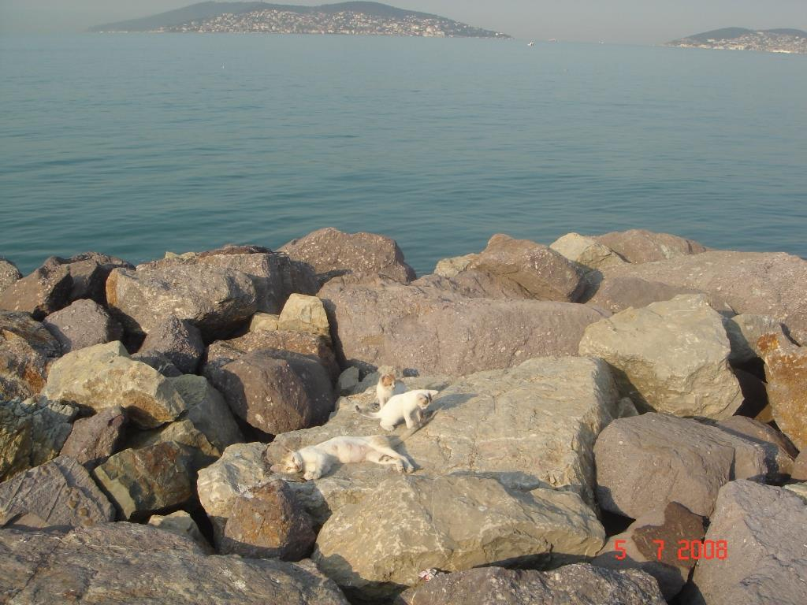
Early Morning Walk
Where are we?
What could we describe?
What would you ask the presenter?
Archive example: Early Morning Walk
bereketeltarchive.com
5
Notes:
Show the photograph and ask participants to identify what they can actually see. The sea and rocks can lead to description, location language and questions about the setting. Invite one descriptive sentence and one question. Halis can add the authentic context in his own words during delivery. Do not supply an invented location, event or memory. Explain that this model can become a student's own short presentation about a place they know or have researched. Distinguish observation from an inference: I can see rocks is an observation, while It may be early in the morning is an inference. The original Early Morning Walk file has 11 slides. Select a few photographs for a short classroom version rather than requiring every image.
Image source: photograph extracted from the user-supplied archive file. Classroom illustration only. Original example authorship should be confirmed before labelling a file as student-created work.

Slide 6
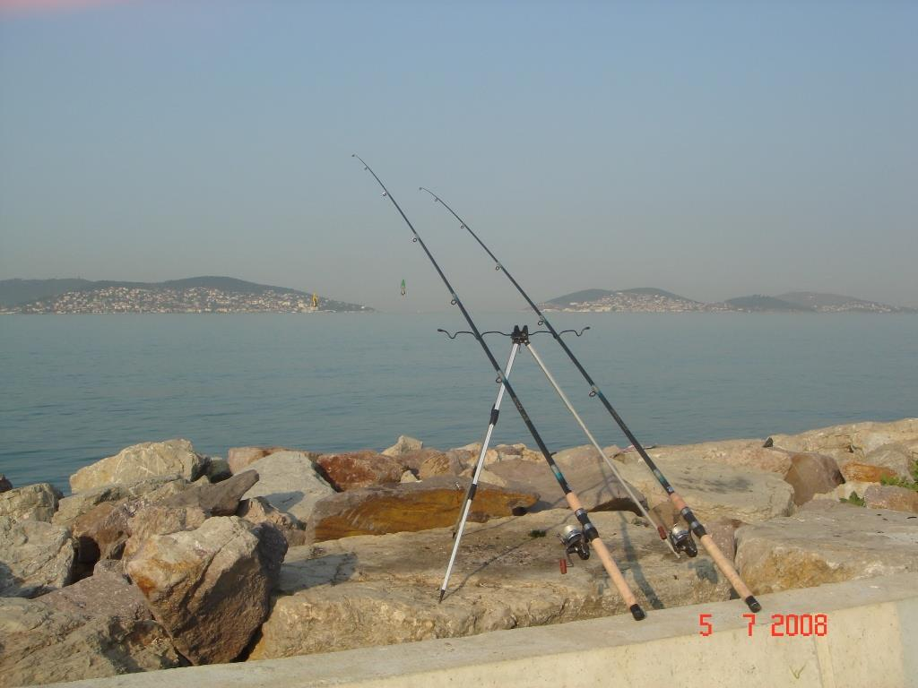
One photograph, different topics
Activities by the sea
Equipment and its purpose
A familiar hobby
Places we enjoy visiting
Possible speaking topics from the same photo
bereketeltarchive.com
6
Notes:
Use the fishing rods to show how the same photograph can support different speaking purposes. One learner may describe the equipment. Another may discuss a hobby or compare places for leisure. Suggested questions include What can you see? What do people use this equipment for? Would you enjoy this activity? Why? Treat the proposed questions as new teaching prompts, not a record of Halis's original classroom wording. Ask the presenter to choose a focus so that the talk has a clear direction. At beginner level, support simple statements and one question. At A2 or B1, invite reasons, comparisons and a short personal or researched account. Allow a learner to say that a question is outside their knowledge.
Image source: photograph extracted from the user-supplied archive file. Classroom illustration only. Original example authorship should be confirmed before labelling a file as student-created work.

Slide 7
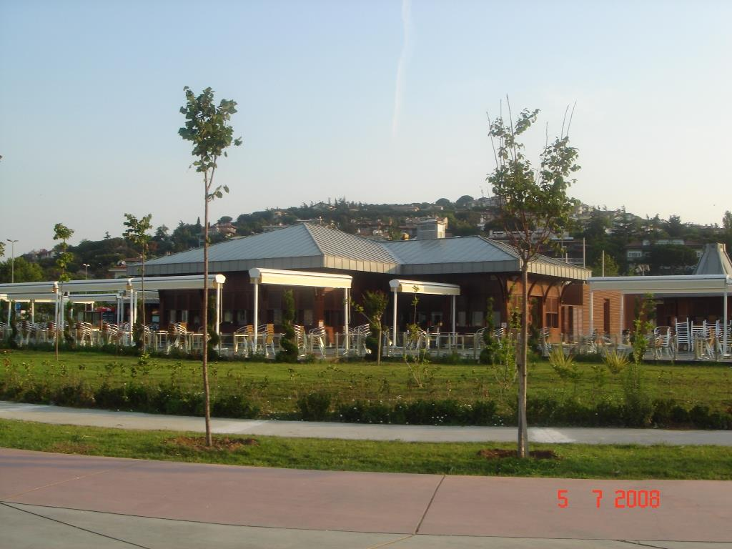
A teacher model
A brief explanation
Keywords beside the image
A pause for a question
An answer in the speaker’s own words
Model the speaking routine before assigning the task
bereketeltarchive.com
7
Notes:
Give a brief model using this photograph of a building beside a landscaped area. Use only details you know or can see. A neutral model might begin This photograph shows a building with trees nearby. I would use it to describe a place and explain why people might visit it. If Halis knows the location and its story, he can replace this neutral wording with his authentic account. Use a keyword card instead of reading a paragraph. Pause and accept a question from the group. Then ask participants what helped them follow the explanation. Highlight the relation between the image and the spoken message. The model should demonstrate the task and leave room for learners to choose their own content.
Image source: photograph extracted from the user-supplied archive file. Classroom illustration only. Original example authorship should be confirmed before labelling a file as student-created work.

Slide 8
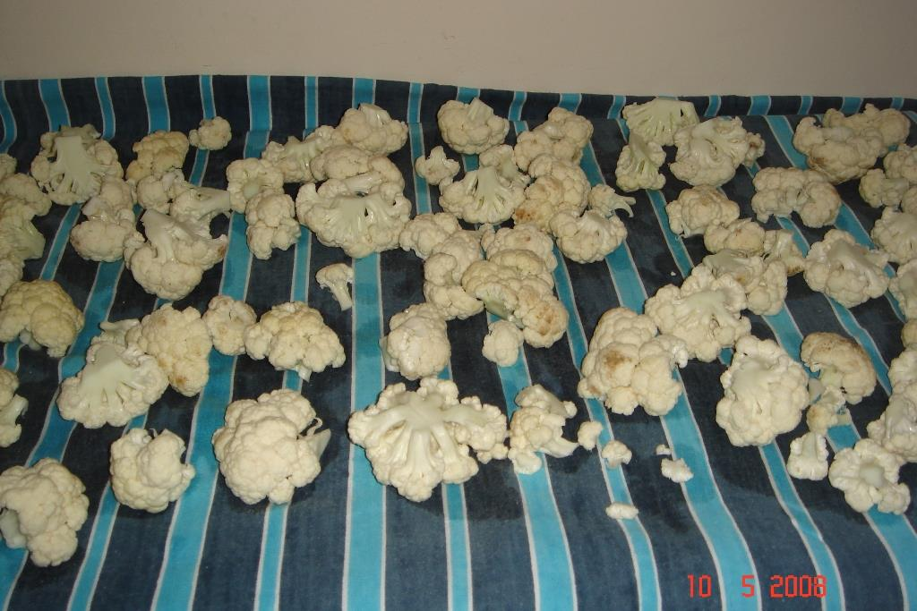
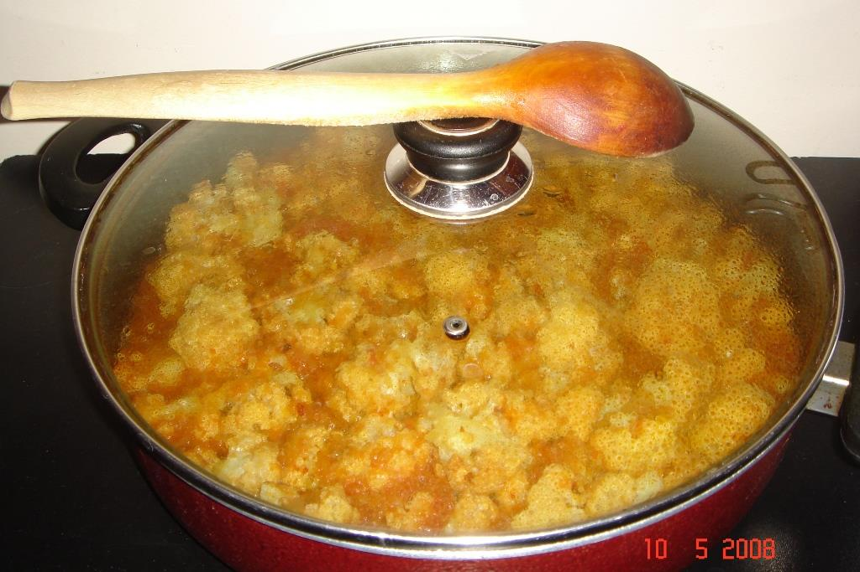
Explaining a process
What happens first?
What changes at each stage?
Which detail needs explanation?
Archive example: Cauliflower Meal and Salad
bereketeltarchive.com
8
Notes:
Show the preparation and cooking photographs. Ask participants to explain the visible difference between them. Useful language includes first, next, after that and finally. The pictures can prompt a process presentation, but they do not provide every step of a recipe. Do not invent quantities or cooking instructions. The supplied Turkmen Pilaf file offers an additional model with ingredients and written steps. Teachers should check its language before classroom reuse, including the typo meet for meat and awkward wording in the carrot instruction. Food preparation is one possible topic. A learner could instead demonstrate how to make a paper model, organise materials or plant a seed. For the seminar, a spoken explanation with photographs is sufficient.
Image source: photograph extracted from the user-supplied archive file. Classroom illustration only. Original example authorship should be confirmed before labelling a file as student-created work.

Slide 9
A manageable task
Suggested starting point
2–3 minutes of speaking
4–6 slides or one poster
1 minute for questions
bereketeltarchive.com
9
Notes:
Present these as starting suggestions, not fixed requirements. A beginner may use one picture and speak for 30 to 60 seconds. A more confident learner may use four to six slides for two or three minutes. A larger project may justify more material, but the amount must fit the speaking purpose. The earlier limit of about ten slides is a useful ceiling for selected sample presentations, not a target every learner must reach. The seminar deck itself is the trainer's resource. The Early Morning Walk and What Is This source files contain more than ten slides and can be sampled. Agree on time, format and listener responsibilities before learners begin. Avoid turning visual design or access to equipment into the main measure of success.

Slide 10
A simple content plan
My topic and purpose
My opening sentence
My main points and visuals
My closing question
bereketeltarchive.com
10
Notes:
Give learners a planning sheet with these four prompts. Ask them to state what they want classmates to understand. A walk presentation might focus on one place or one observation. A process presentation might explain three stages. Learners should match each visual to a point they can explain and finish with a question that invites a response. The plan is an outline, not a script to memorise. Check that each learner understands the content they intend to use. If learners consult a source, have them record it and explain the information in language they understand. For personal photographs, a brief oral explanation of where the picture came from may be enough for the classroom task. Public sharing requires a separate check.

Slide 11
Language support and notes
This picture shows …
First … Then … Finally …
I chose this because …
Could you explain …?
bereketeltarchive.com
11
Notes:
Offer a small set of useful phrases that fits the chosen task. Description needs expressions such as This picture shows and There is. A process needs sequence language. An opinion needs a reason. Model one sentence, then invite learners to change it for their topic. A keyword card can contain a place, an action and a reason. Beginners may need a complete opening sentence or a few written sentences at first. Gradually reduce the support when they are ready. The What Colour and What Is This files provide short question-and-answer patterns. Extend these into learner-created tasks: choose an object, describe it and answer a classmate's question about its use. Do not infer independent spoken ability solely from a prepared slide.

Slide 12
Rehearsal with a partner
Speak once with your notes
Your partner asks one question
Choose one improvement
Speak again
bereketeltarchive.com
12
Notes:
Pair learners before the whole-class presentation. The first speaker gives a short explanation while the partner listens for the main point. The partner then asks a relevant question and offers one specific comment, for example I understood the first stage, but I need to hear more about the last stage. The speaker chooses one change and repeats the presentation or the difficult section. Partners then exchange roles. Rehearsal can reveal missing information, unclear sequence or excessive dependence on written text. Ask learners to focus on communication rather than correcting every error at once. A teacher may circulate to help with essential vocabulary and organisation. This routine is a suggested adaptation that can be used with slides, posters or physical materials.

Slide 13
The audience’s listening task
Note the main message
Record one useful detail
Prepare a relevant question
Make a connection to your own experience
bereketeltarchive.com
13
Notes:
Give listeners a small task before the presentation starts. They can note the main message and one detail, then prepare a question. In a small group, each listener can ask a question. In a large class, give everyone thinking time and invite selected questions, rotating who speaks across presentations. A comparison question can involve the whole group: Would you choose the same activity or method? Why? Make clear that presenters and listeners both have work to do. Avoid an extensive worksheet that draws attention away from the speaker. For beginners, listeners can draw or select a picture and ask a rehearsed question. For more advanced learners, they can summarise a point before asking for clarification.

Slide 14
Questions and responses
How does … work?
Why did you choose …?
Could you give an example?
Could you repeat the question?
bereketeltarchive.com
14
Notes:
Model a short exchange. For example, after a process presentation a listener asks Why do you do that first? The presenter gives a reason if they know it. If they do not know, they can say I am not sure or I will check that. Teach repair phrases such as Could you repeat the question? and Do you mean the first picture? Questions should follow the actual content and allow a respectful answer. Avoid forcing the presenter to disclose personal information. At beginner level, offer two question stems to choose from. At A2 or B1, invite an unprepared follow-up that asks for a reason or example. Allow a short pause before the answer. Evaluate the effort to clarify meaning as well as the language used.

Slide 15
Useful feedback
One clear message
One effective explanation
One response to a question
One next step
bereketeltarchive.com
15
Notes:
Explain the assessment focus before presentations begin. A listener might say Your pictures helped me follow the stages. Next time, explain what happens between the second and third pictures. The teacher can comment on content, organisation, intelligibility and interaction. A visible pause or a language error does not automatically mean communication failed. Choose one language point to practise after the presentation if it affects meaning or is useful for the next task. Give learners a chance to present again, even briefly, after feedback. Do not equate confidence with loudness or polished slides with speaking skill. The Teacher's Notes include a formative four-criterion rubric. It is a proposed tool and does not represent validated scores from the archive examples.

Slide 16
Participation for different learners
A familiar or researched topic
A choice of presentation format
Partner or small-group delivery
Support that can gradually decrease
bereketeltarchive.com
16
Notes:
Let learners choose a feasible topic and format. A shy learner may first present to a partner or a small group. A pair presentation should give both learners a speaking part and an opportunity to answer a question. A learner without a device can use a poster, a photograph or an object. Give planning time and vocabulary support while preserving decisions the learner can make independently. Adapt the task for access needs, including visual descriptions or suitable positioning of materials. Invite respectful questions and avoid public ridicule. If the class later shares work online, review permission and remove identifying information where necessary. The immediate classroom task should remain achievable with the resources learners actually have.

Slide 17
Workshop planning task
Choose one topic and format
Prepare a 60-second explanation
Use up to three visuals or one object
Finish with a question for listeners
bereketeltarchive.com
17
Notes:
Allow three minutes for participants to plan in pairs. Offer topics drawn from the archive, such as a place I know, an everyday process or an object I use, and allow their own ideas. Each participant prepares a 60-second explanation. Paper notes, a simple sketch or an available object are enough for this workshop. Ask them to state an opening sentence, two main points and a closing question. They may use the printed planning page in the Teacher's Notes. Remind them to select a speaking purpose instead of listing everything about the topic. While participants work, check that each person will have a speaking turn. This workshop is a short simulation of the learner routine rather than a finished classroom project.

Slide 18
Mini presentations
Speak for 60 seconds
Listen for the main point
Ask and answer a question
Offer one specific comment
bereketeltarchive.com
18
Notes:
Give pairs four minutes in total. Participant A speaks for one minute, then Participant B asks a question and gives a brief specific comment. They exchange roles. Keep the timing visible and remind participants to use their notes flexibly. Allow three additional minutes for a short whole-group discussion. Ask What did your listener's question make you explain? and What support would your learners need? Select a few responses. The aim is to experience a content-based exchange and identify adaptations. Participants can revise one sentence or one point after the exchange. In a larger workshop, groups of three can rotate speaker, listener and observer roles, provided each person receives a speaking turn within the available time.

Slide 19
A classroom plan
Who are the learners?
What will they explain?
What support will they need?
How will listeners take part?
bereketeltarchive.com
19
Notes:
Give two minutes for participants to write an achievable classroom plan. Ask them to specify the learner level, topic choices, format, speaking time, support and listener task. Invite them to choose how they will observe progress, for example whether a learner can explain a sequence more clearly on a second attempt or respond to a follow-up question with less support. Compare work under similar conditions before drawing a conclusion. The archive examples illustrate possibilities and are not proof of measured improvement. Ask participants to identify one task they can try soon and one practical constraint they will address. Collect one or two ideas if time permits. The Procedure gives a classroom cycle that can be spread across two lessons.

Slide 20
Reflection and next use
What did the speaker explain?
How did the audience respond?
What should happen next time?
bereketeltarchive.com
bereketeltarchive.com
20
Notes:
Close by returning to the speaking purpose. A student-created presentation becomes useful classroom practice when the learner can explain chosen content and the audience can respond. Invite each participant to write one next step for their teaching. Remind them that a short task with a clear purpose can be repeated with a new topic and reduced support. The archive supplies examples and companion guidance for adaptation. Thank participants and display the website. Avoid claiming guaranteed gains in fluency or confidence. Any evaluation of improvement needs observations or recordings from learners over time under comparable conditions. End with a final participant question if time allows.

