Slide 1
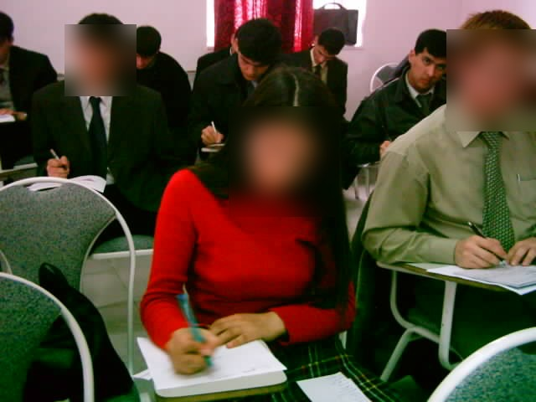
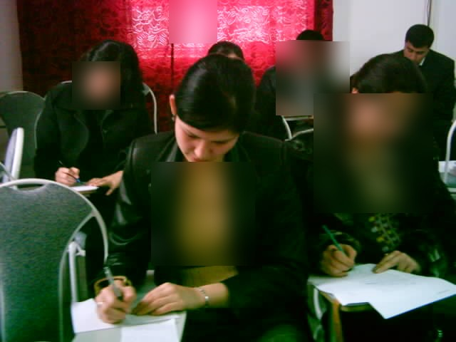
Using Dictation in ELT
Interactive and communicative dictation activities for English classes
Developed by Halis Bereket
Listening • Writing • Checking • Speaking

Slide 2
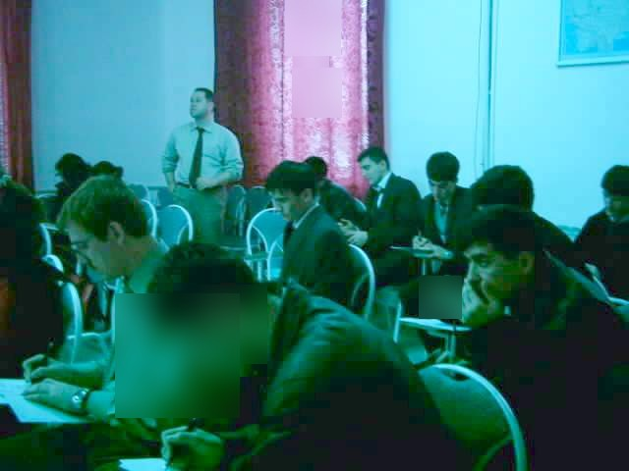
Why dictation still matters
Accuracy and fluency
All four skills
Classroom energy
Dictation can support attentive listening, spelling, pronunciation, note-taking and self-evaluation.
Student-led variations turn dictation into a listening, speaking, reading and writing activity.
When used imaginatively, dictation adds variety and concentration without heavy preparation.
Useful at different levels when the text is graded.
Effective as review, lead-in, practice or checking activity.
Learners notice their own listening and writing errors.
BEREKET ELT Archive | Dictation in ELT

Slide 3
What is dictation?
A simple technique becomes powerful when the procedure is varied.
A text is read or played aloud, and learners write down what they hear.
Not only teacher reading
Not only word-for-word
Not only writing
The dictating voice can be the teacher, a recording, a student, a pair, or even a group.
Learners can listen for gist, key words, errors, missing parts, pictures, colours or meaning chunks.
Many versions lead naturally to speaking, pronunciation, reconstruction and peer checking.
BEREKET ELT Archive | Dictation in ELT

Slide 4
Halis Bereket’s 3-listening model
1. Listen only
2. Listen and write
3. Check and correct
Students listen at normal speed and try to catch the general meaning. No writing yet.
Students listen again with pauses or breaks and write the sentences or chunks.
Students listen once more and correct their own work before comparing.
Seminar message: Dictation is not a punishment; it is a guided listening-and-noticing activity.
BEREKET ELT Archive | Dictation in ELT

Slide 5

A classroom quiz sample: Listen and write
Students receive a short worksheet with numbered blanks.
The audio is played in the 3-listening sequence.
Checking becomes a learning stage, not just marking.
Name, Surname:
Listen and write. (Quiz 10)
It's _____________. _____________ _____________ _____________ _____________.
It's _____________. _____________ _____________ _____________.
It's _____________. _____________ _____________ _____________.
It's _____________. _____________ _____________ _____________.
It's _____________. _____________ _____________ _____________.
It's _____________. _____________ _____________ _____________.
PowerPoint setting
Start the sound on click, not automatically. This gives the presenter control before each listening stage.
BEREKET ELT Archive | Dictation in ELT

Slide 6
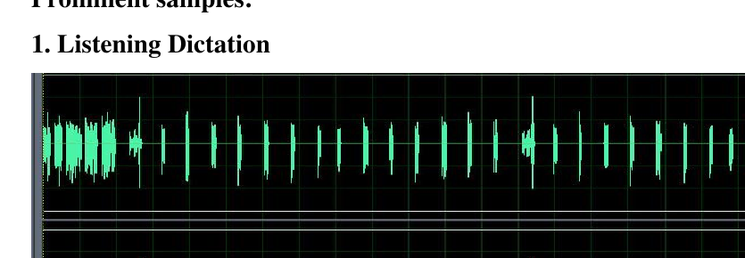
How to prepare a Listening Dictation sample
Choose 6-10 short target sentences from a familiar text or audio.
First listening: natural and uninterrupted - listen only.
Second listening: use pauses (about 12 seconds in the original version) so learners can write.
Third listening: check and correct; pause if careful correction is needed.
Earlier Cool Edit version: about 10 seconds silence + a brief warning cue before writing.
BEREKET ELT Archive | Dictation in ELT

Slide 7
Classroom-tested application
Real classroom photos can be used briefly to show that the activity was applied with university students. Faces should remain blurred or covered for public use.
BEREKET ELT Archive | Dictation in ELT

Slide 8
Rolling and False Reading Dictation
Rolling Dictation
False Reading Dictation
Learners hear a text or story with missing words. The recording/teacher reads twice without stopping; learners fill in gaps.
The teacher tells a story, then retells it with wrong words. Students listen, stop the teacher and correct the mistakes.
These versions connect dictation with vocabulary review, listening for detail and speaking correction.
BEREKET ELT Archive | Dictation in ELT

Slide 9
Fast Flash Dictation family
Pictures
Vocabulary
Stories
Show 10-15 pictures quickly; groups remember and list what they saw.
Flash recently studied words from one lexical area.
Connect flashed pictures into a short narrative.
Text
Flash chunks faster than learners can copy; they must catch meaning and structure.
BEREKET ELT Archive | Dictation in ELT

Slide 10
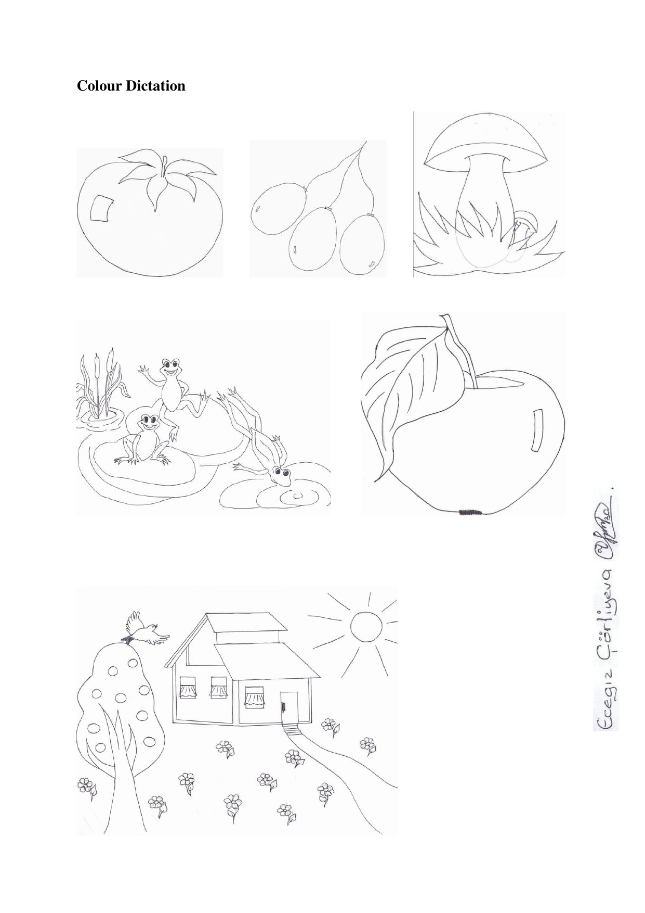

Colour Dictation and Picasso Dictation
Visual dictations reduce anxiety and make instructions meaningful, especially with young learners.
BEREKET ELT Archive | Dictation in ELT

Slide 11
Shouting Dictation
Pair-work structure
Classroom effect
Two students have different versions of the same text. Each one dictates missing parts to the other.
Learners listen carefully, speak clearly and negotiate meaning. It can be lively but purposeful.
Teacher reminder: a lively classroom is not a noisy classroom; the activity needs clear rules, distance and a time limit.
BEREKET ELT Archive | Dictation in ELT

Slide 12
Dictogloss, Mistakes and Bad Cold Dictation
Dictogloss
Mistakes Dictation
Bad Cold
Learners listen for general meaning, take notes, reconstruct the text and compare with the original.
Students correct grammar or meaning errors in a dictated or printed text.
The teacher “loses” a word by coughing or sneezing; learners choose a sensible word to fit the gap.
These variations turn dictation into problem solving, reconstruction and creative language use.
BEREKET ELT Archive | Dictation in ELT

Slide 13
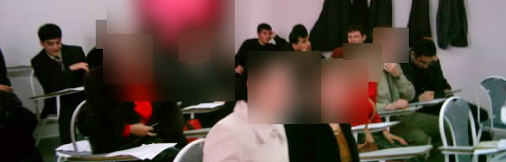
Running / Wall Dictation
Set-up
Action
Focus
Stick short texts on the wall or board. Divide the class into teams. Each team has a secretary.
Runners read a sentence, keep it in mind and dictate it to the secretary.
Writing, memory, pronunciation and teamwork are all active at the same time.
BEREKET ELT Archive | Dictation in ELT

Slide 14
Practical teacher tips
Explain the purpose before starting.
Grade the text carefully: too hard becomes stressful.
Read or play at natural speed. Avoid isolated word units.
Use sense groups when pausing.
Let students notice and correct their own errors.
Use short activities often rather than long activities rarely.
BEREKET ELT Archive | Dictation in ELT

Slide 15
Suggested seminar flow
1. Warm-up
2. Method
3. Demo
4. Variations
What do teachers remember about dictation?
Why dictation can support listening and accuracy.
Run the 3-listening sample with participants.
Show selected activity types with short examples.
5. Design
6. Share
Participants adapt one dictation activity for their class.
Pairs/groups present their activity idea.
BEREKET ELT Archive | Dictation in ELT

Slide 16
Keep in mind
Dictation becomes powerful when learners listen with a purpose, write with attention, and check with understanding.
BEREKET ELT Archive
bereketeltarchive.com

