Slide 1
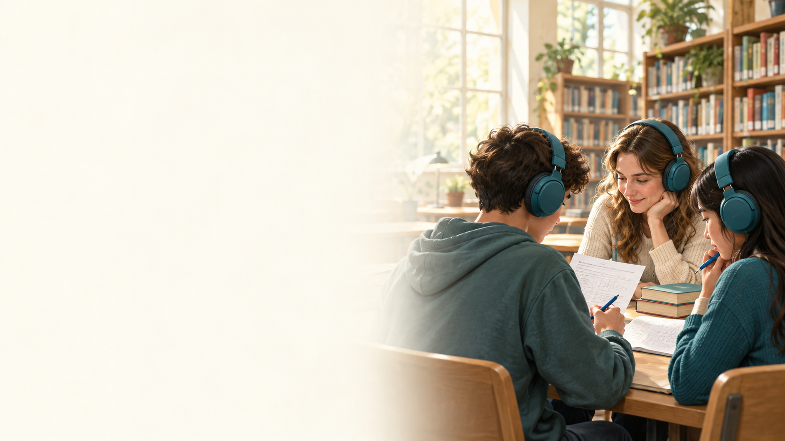
KEEP IN MIND
A2 Speaking Practice 2
10 speaking activities
Listen and repeat.
Answer the question about the recording.
Then talk about yourself.
BEREKET ELT Archive

Slide 2

KEEP IN MIND
Activity 1
Listen and repeat.
Listen and answer
When does Maria water the flowers?
Talk about yourself
What do you do before leaving home?
Click the speaker to play again.
BEREKET ELT Archive
Notes:
Recording 09_06
Maria waters the flowers before opening her small shop.
Comprehension answer: Before opening her shop.
Personal example: I check my bag and close the door.
Accept other suitable personal responses.

Slide 3
KEEP IN MIND
Activity 2
Listen and repeat.
Listen and answer
How are the couple waiting?
Talk about yourself
What do you do while waiting for a bus or train?
Click the speaker to play again.
BEREKET ELT Archive
Notes:
Recording 09_07
An elderly couple waits quietly for the morning train.
Comprehension answer: They are waiting quietly.
Personal example: I read a book or listen to music.
Accept other suitable personal responses.

Slide 4
KEEP IN MIND
Activity 3
Listen and repeat.
Listen and answer
How does the nurse travel in pleasant weather?
Talk about yourself
How does the weather change your travel plans?
Click the speaker to play again.
BEREKET ELT Archive
Notes:
Recording 10_01
A nurse cycles to work when the weather is pleasant.
Comprehension answer: By bicycle.
Personal example: When it rains, I take the bus instead of walking.
Accept other suitable personal responses.

Slide 5
KEEP IN MIND
Activity 4
Listen and repeat.
Listen and answer
When does Sophie practise the piano?
Talk about yourself
What skill would you like to practise and when?
Click the speaker to play again.
BEREKET ELT Archive
Notes:
Recording 10_03
Sophie practises the piano for half an hour before breakfast.
Comprehension answer: Before breakfast.
Personal example: I would like to practise drawing after school.
Accept other suitable personal responses.

Slide 6
KEEP IN MIND
Activity 5
Listen and repeat.
Listen and answer
Where does Michael carry the heavy boxes?
Talk about yourself
How can you help someone near your home?
Click the speaker to play again.
BEREKET ELT Archive
Notes:
Recording 10_07
Michael carefully carries heavy boxes upstairs for his elderly neighbour.
Comprehension answer: He carries them upstairs.
Personal example: I can carry a shopping bag for a neighbour.
Accept other suitable personal responses.

Slide 7
KEEP IN MIND
Activity 6
Listen and repeat.
Listen and answer
Where are the passengers waiting?
Talk about yourself
Describe a station or bus stop you know.
Click the speaker to play again.
BEREKET ELT Archive
Notes:
Recording 10_08
Passengers wait patiently inside the station until their train arrives.
Comprehension answer: Inside the station.
Personal example: The station near my home is small. It has a waiting room.
Accept other suitable personal responses.

Slide 8
KEEP IN MIND
Activity 7
Listen and repeat.
Listen and answer
Where does Rachel find a seat?
Talk about yourself
Where do you like to sit in a café and why?
Click the speaker to play again.
BEREKET ELT Archive
Notes:
Recording 11_02
Rachel orders a sandwich, then finds a seat near the window.
Comprehension answer: Near the window.
Personal example: I like to sit near a window because I can see outside.
Accept other suitable personal responses.

Slide 9
KEEP IN MIND
Activity 8
Listen and repeat.
Listen and answer
What happened before someone found the keys?
Talk about yourself
You find someone's keys. What do you do?
Click the speaker to play again.
BEREKET ELT Archive
Notes:
Recording 11_04
Peter dropped his keys, but someone found them near the entrance.
Comprehension answer: Peter dropped them.
Personal example: I give them to a member of staff.
Accept other suitable personal responses.

Slide 10
KEEP IN MIND
Activity 9
Listen and repeat.
Listen and answer
What did Linda do after missing her appointment?
Talk about yourself
What can you say when you are late for an appointment?
Click the speaker to play again.
BEREKET ELT Archive
Notes:
Recording 12_02
Linda missed her appointment, so she immediately called the office to apologise.
Comprehension answer: She immediately called the office to apologise.
Personal example: I am sorry I am late. My bus was delayed.
Accept other suitable personal responses.

Slide 11
KEEP IN MIND
Activity 10
Listen and repeat.
Listen and answer
What do the two teenagers find?
Talk about yourself
You find a wallet. What do you do?
Click the speaker to play again.
BEREKET ELT Archive
Notes:
Recording 12_03
Two teenagers discover a lost wallet and take it to the police.
Comprehension answer: They find a lost wallet.
Personal example: I take it to the police or ask a trusted adult for help.
Accept other suitable personal responses.

Slide 12
KEEP IN MIND
Example answers 1 and 2
Activity 1
Before opening her shop.
Personal example: I check my bag and close the door.
Activity 2
They are waiting quietly.
Personal example: I read a book or listen to music.
BEREKET ELT Archive
Notes:
Personal responses are examples. Accept other appropriate answers.

Slide 13
KEEP IN MIND
Example answers 3 and 4
Activity 3
By bicycle.
Personal example: When it rains, I take the bus instead of walking.
Activity 4
Before breakfast.
Personal example: I would like to practise drawing after school.
BEREKET ELT Archive
Notes:
Personal responses are examples. Accept other appropriate answers.

Slide 14
KEEP IN MIND
Example answers 5 and 6
Activity 5
He carries them upstairs.
Personal example: I can carry a shopping bag for a neighbour.
Activity 6
Inside the station.
Personal example: The station near my home is small. It has a waiting room.
BEREKET ELT Archive
Notes:
Personal responses are examples. Accept other appropriate answers.

Slide 15
KEEP IN MIND
Example answers 7 and 8
Activity 7
Near the window.
Personal example: I like to sit near a window because I can see outside.
Activity 8
Peter dropped them.
Personal example: I give them to a member of staff.
BEREKET ELT Archive
Notes:
Personal responses are examples. Accept other appropriate answers.

Slide 16
KEEP IN MIND
Example answers 9 and 10
Activity 9
She immediately called the office to apologise.
Personal example: I am sorry I am late. My bus was delayed.
Activity 10
They find a lost wallet.
Personal example: I take it to the police or ask a trusted adult for help.
BEREKET ELT Archive
Notes:
Personal responses are examples. Accept other appropriate answers.

